Slide 1
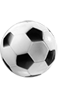

Enhancing Predictive Modeling in the Premier League with Parameterized Quantum Circuits (PQCs)
Abdul Haleem Abdul Salam
Mohanad Alkhalaf
Yu Jiyun Chang
Sai Nityamani Sahith Matsa
Yang Ren

Slide 2
Contents
Introduction
Quiz 4
Phase I - Classical Machine Learning
Phase II - Quantum Machine Learning
One Qubit
Multiple Qubits
PQC Advantages and Real-World Application
Conclusion

Slide 3

Introduction to
Predictive Modeling
Definition:
Predictive modeling uses statistical and machine learning techniques to forecast outcomes based on historical data
Applications in Football:
Match Outcome Predictions
Player Performance Forecasting
Team Strategy Optimization
Importance in Business:
Helps clubs make strategic decisions
Engages fans through fantasy football and betting platforms

Slide 4
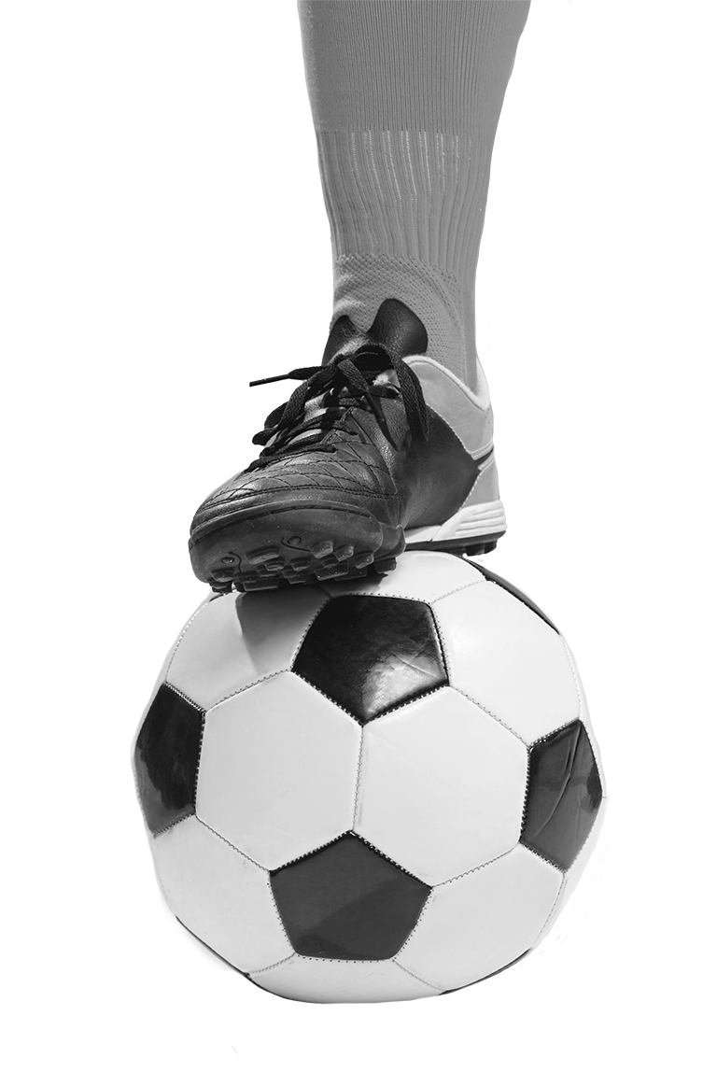
Comparison Table
 | Classical | Quantum
Outcome Prediction | Deterministic | Probabilistic
Handling Complexity | Limited | Superior
Speed | Slower for large datasets | Potentially faster
Scalability | Limited by classical hardware | Promising with quantum tech

Slide 5



Slide 6


Team
Selection
Liverpool

Slide 7
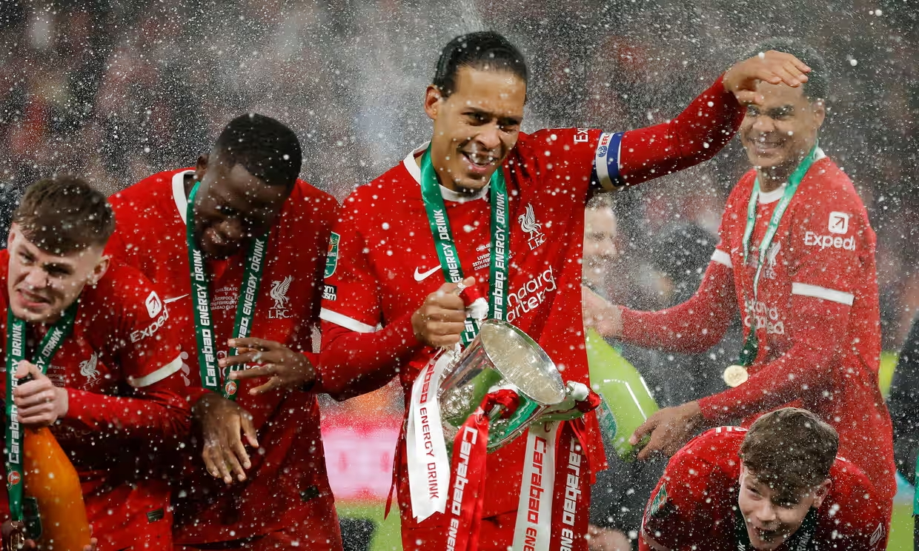
Quiz 4 Dataset
Final Project Dataset
Data filtered by Liverpool home and away games
Games filtered by win or lose
Games where the result has been draw is removed
Season 2013-2014 has been considered for this dataset
More features inclusion such as attack strength and defensive strength for quantum machine learning translation
Notes:
How we expand the project from quiz 4 to final project.

Slide 8
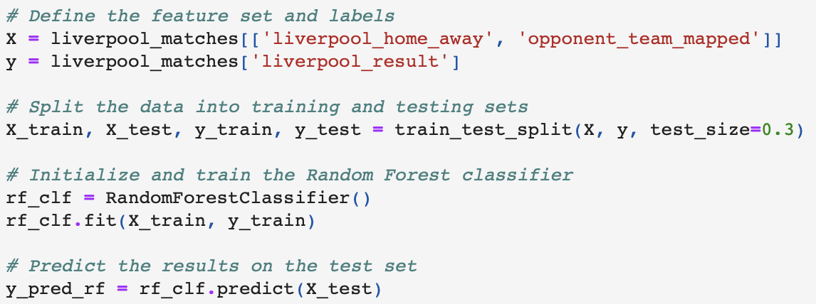
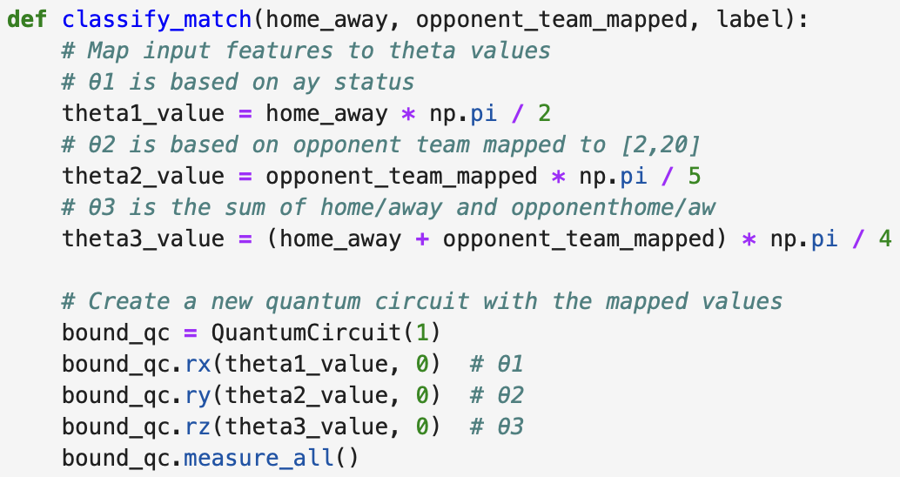
Overview of Classical vs Quantum Methods
Classical Methods
Use traditional algorithms like Logistic Regression, Random Forests, Neural Networks
Sequential data processing
Quantum Methods
Leverage quantum properties like superposition and entanglement
Enable parallel processing and handle more complex datasets

Slide 9
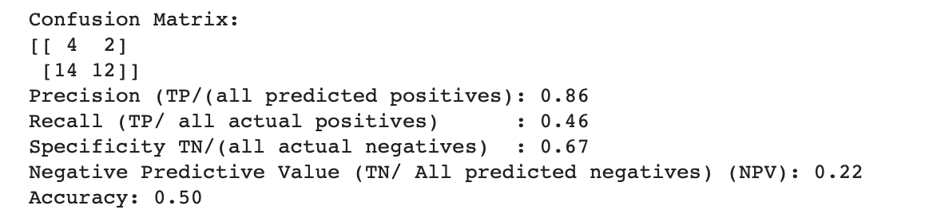
Quiz 4 - Quantum Model Example
Key Steps:
Use one qubit with parameterized gates (rx, ry, rz) based on match features (PQC)
Map rotation angles to the features of the match
θ1: Home/Away status
θ2: Opponent team
θ3: Combined features
Execute the circuit using qasm_simulator
Classify the match result
Evaluate model's performance
Notes:
True Positive: 4 / False Positive: 2
False Negative: 14 / True Negative: 12

Slide 10
Project Phases Overview
Phase I
Classical Machine Learning
Phase II
Quantum Machine Learning Translation
Phase III
Naive Bayes in Classical and Quantum Methods

Slide 11
Phase I
Classical Machine Learning
(Predicting Game Winners)
Objective:
Build a classical machine learning model using Random Forest to predict game winners in the Premier League for Liverpool games in 2013-2014
Approach:
Start with a Random Forest classifier to predict match outcomes (win, lose)
Refine the model by domain knowledge, feature selection and adding more match features
Notes:
Choosing Random Forest Classifier vs Logistic Regression?
Random Forest is ideal because it captures complex, non-linear relationships in football match data, handles categorical features like home/away games, and is robust to outliers. It also provides feature importance insights and reduces overfitting through averaging multiple decision trees, making it more reliable than Logistic Regression for this task.

Slide 12
TASKS
Data Preprocessing and Exploration
Feature Selection and Engineering
Model Training and Evaluation
Gather and clean historical match data (e.g., goals, shots, possession, passes)
Select important match features such as home advantage, team form, player injuries, and head-to-head results
Train the Random Forest model and evaluate its performance using metrics like accuracy, precision, and recall

Slide 13
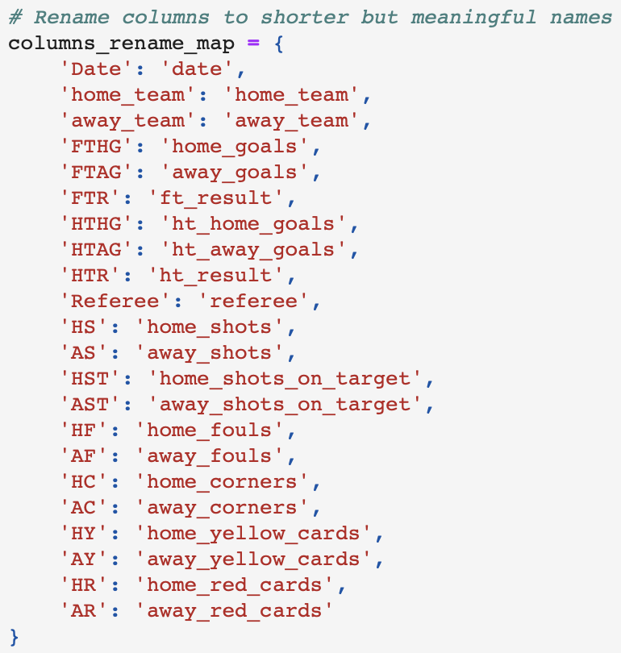
Phase I - Classical Machine Learning
Task 1: Data Preprocessing and Exploration
Prepare datasets and ensure the column names match for merging
Rename columns to shorter but meaningful names and apply the renaming
Select only the specified columns

Slide 14
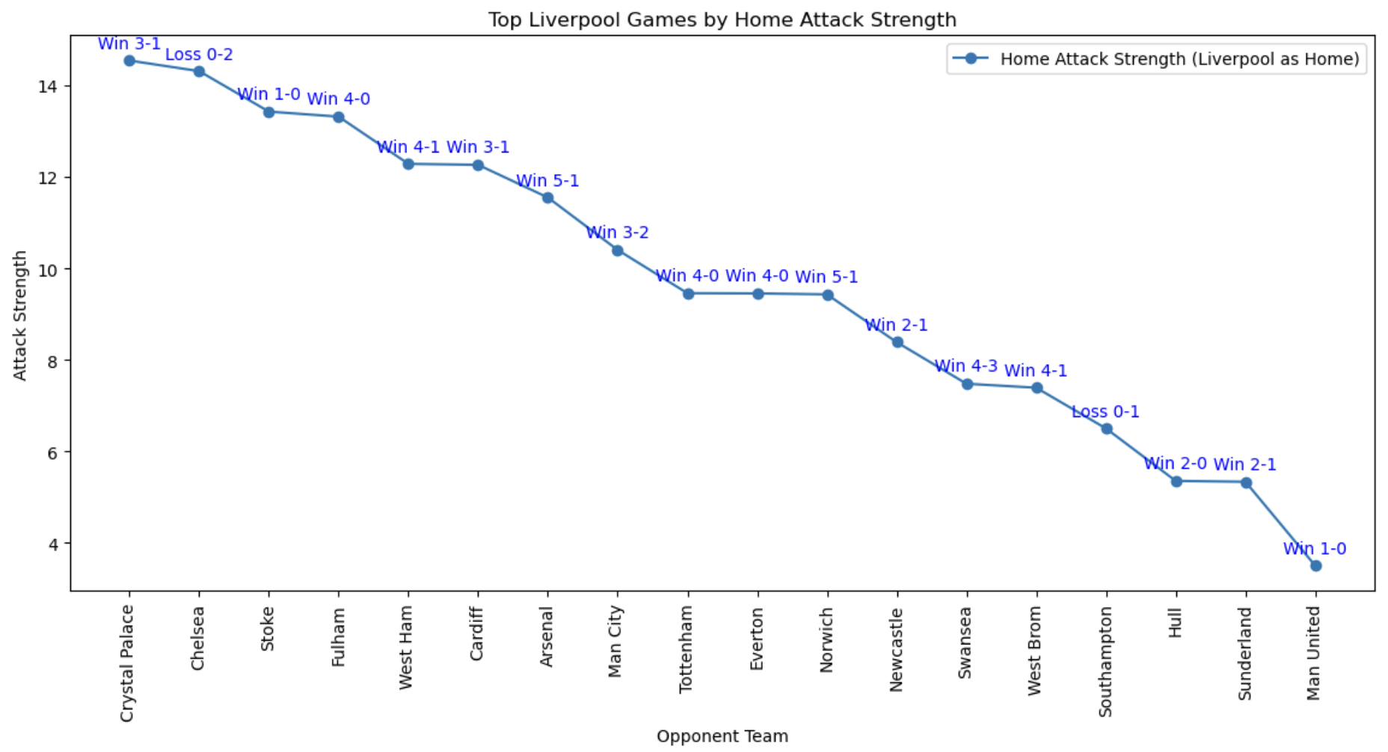
Phase I - Classical Machine Learning
Task 2: Feature Selection and Engineering
Home Attack Strength
The number of goals the home team scores
The shot on target / the total shots
→ How accurate the team's attacks are
The number of corners
→ Opportunities to create chance

Slide 15
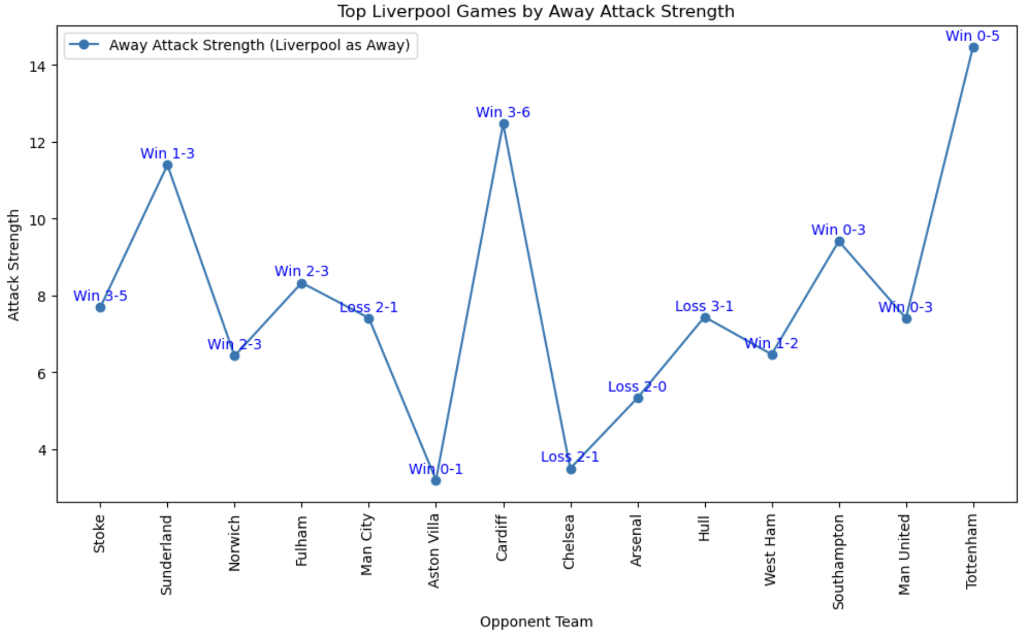
Phase I - Classical Machine Learning
Task 2: Feature Selection and Engineering
Away Attack Strength
The goals scored by the away team
The shot on target / the total shots
The number of corners they win

Slide 16
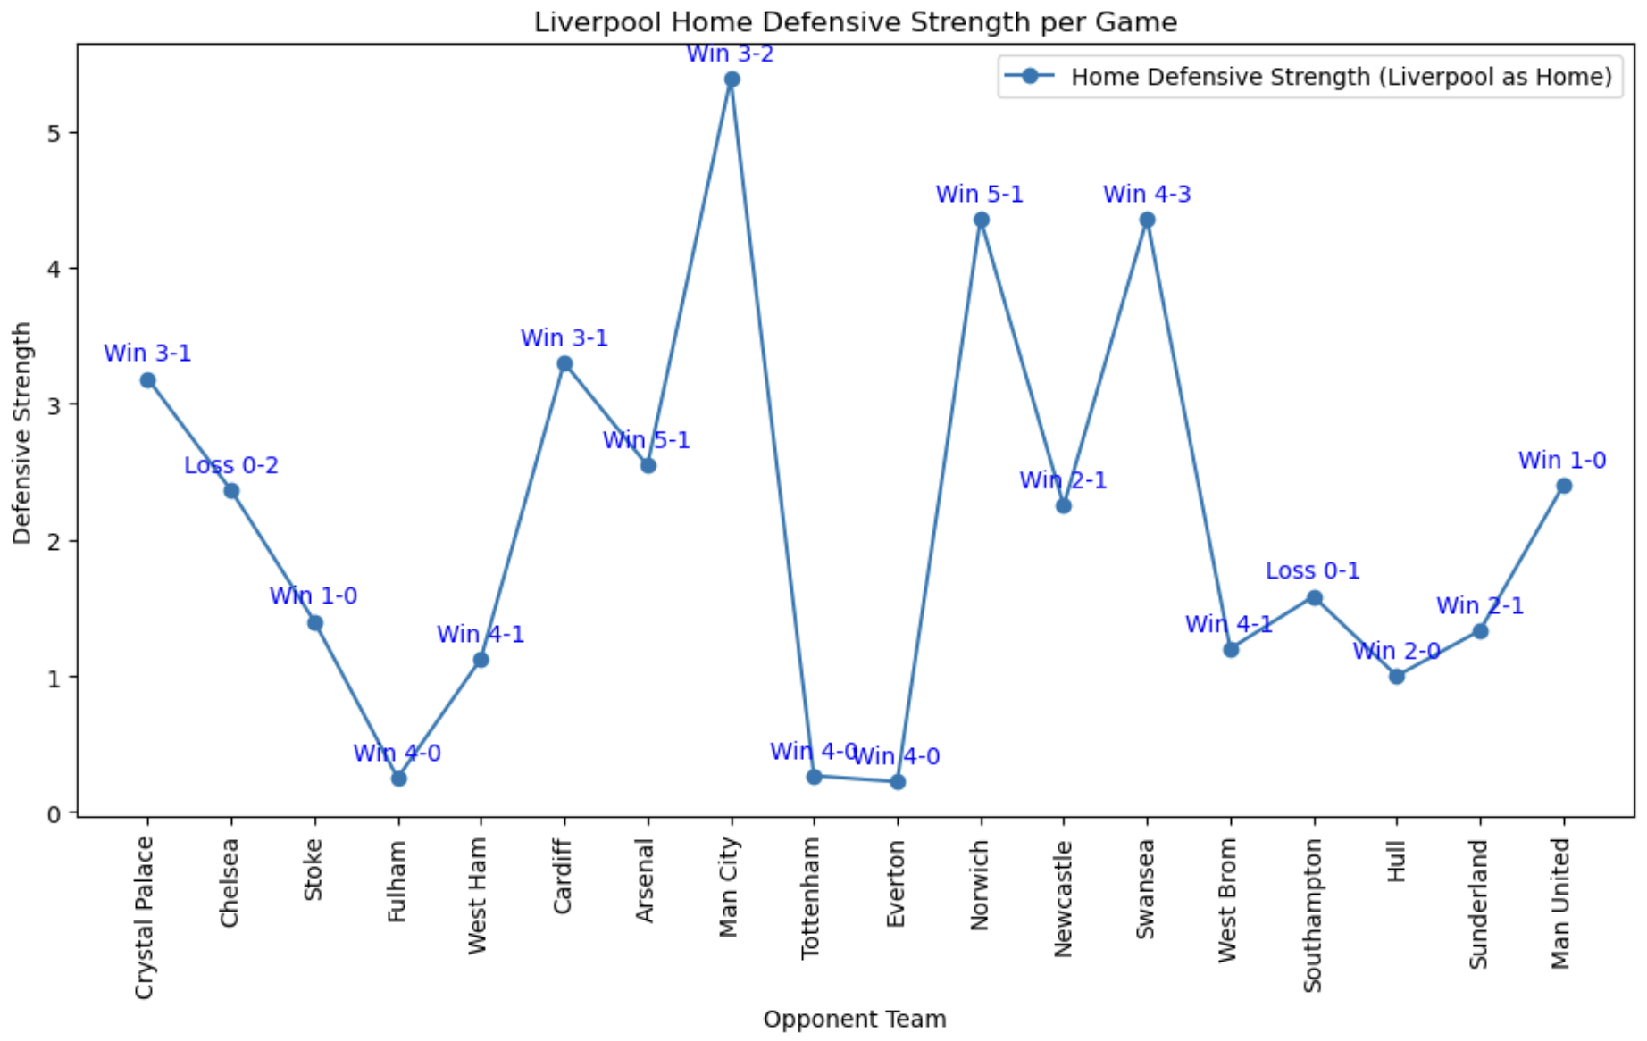
Phase I - Classical Machine Learning
Task 2: Feature Selection and Engineering
Home Defensive Strength
The goals scored by the away team
The shots on target they allow / the total shots from the away team
The number of yellow cards they receive
→ More yellow cards suggest defensive mistakes
The number of red cards
→ Red cards have double the impact

Slide 17
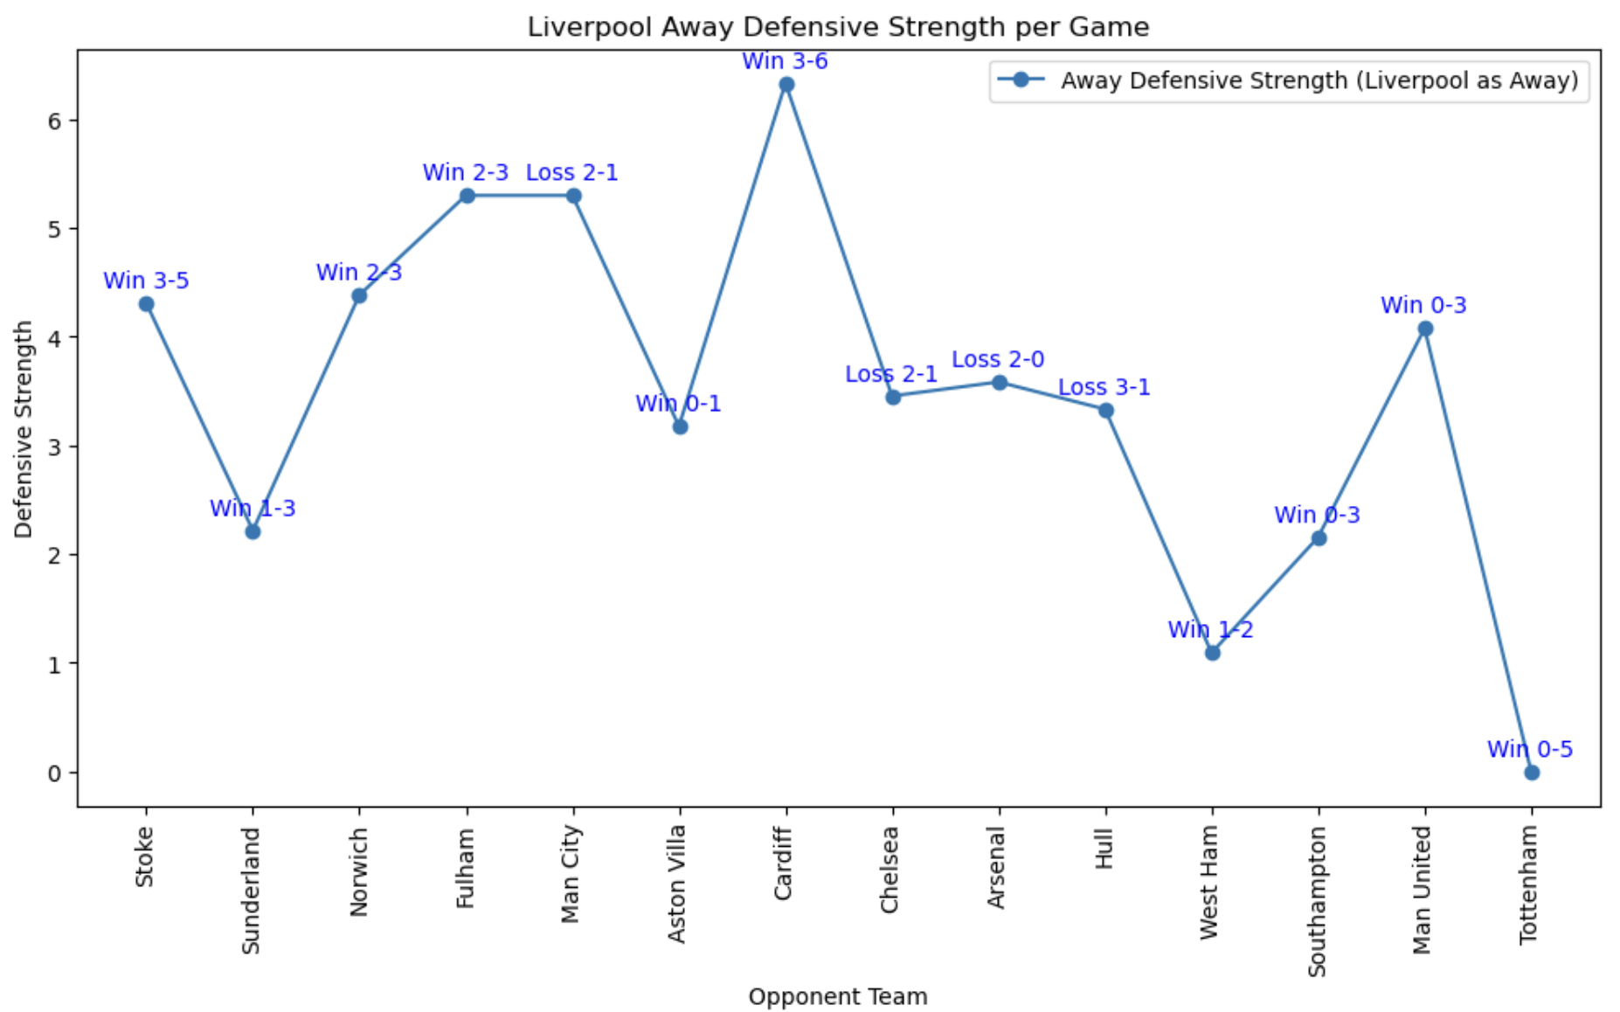
Phase I - Classical Machine Learning
Task 2: Feature Selection and Engineering
Away Defensive Strength
The goals scored by the home team
The shots on target allowed by the away team / the total shots from the home team
The number of yellow cards they receive
The number of red cards

Slide 18
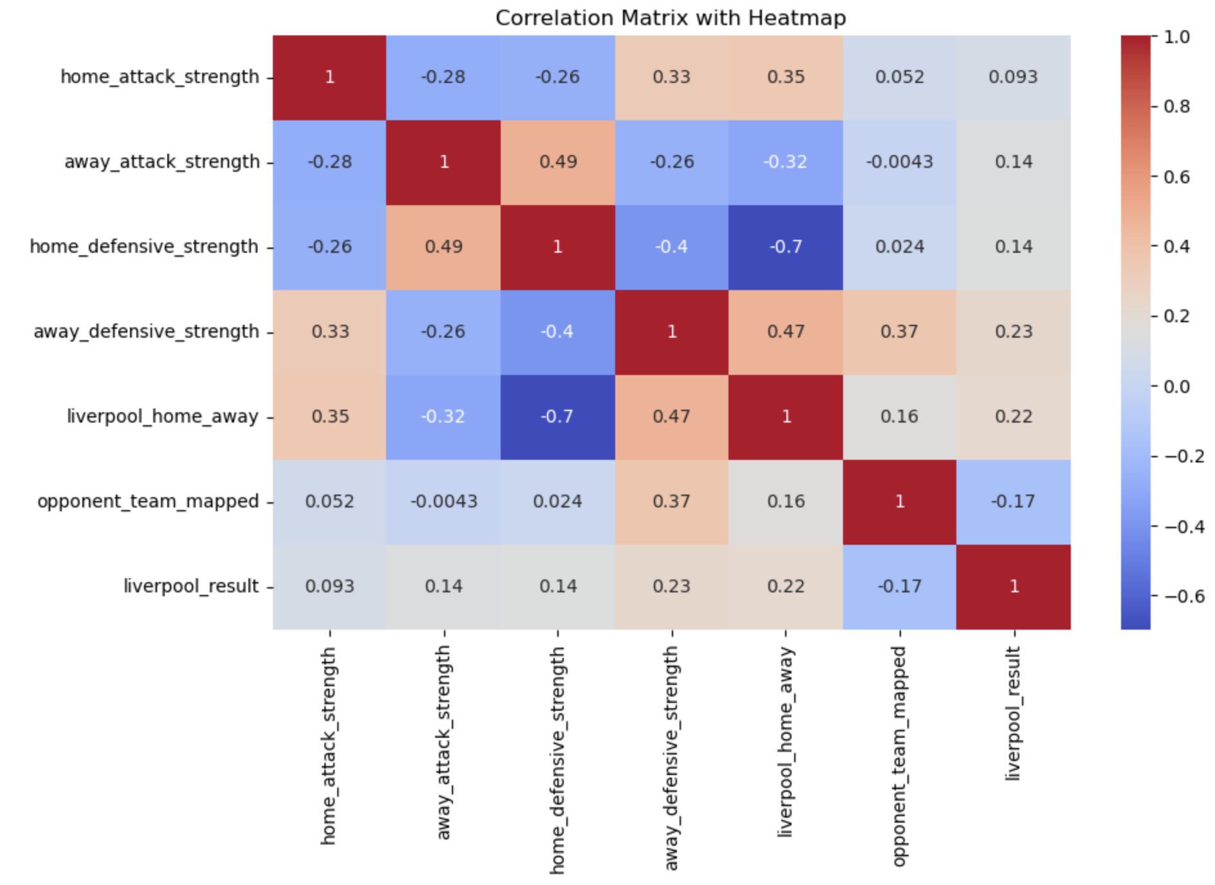
Correlation matrix (Heatmap)

Slide 19
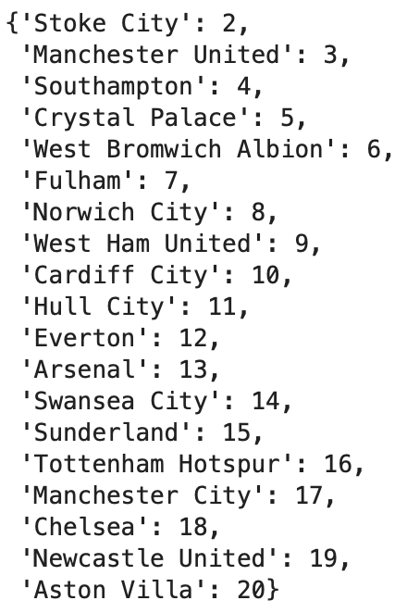
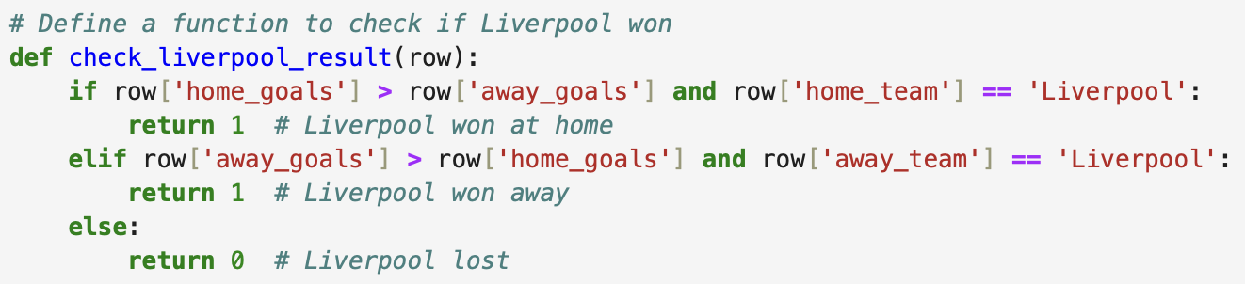
Phase I - Classical Machine Learning
Task 2: Feature Selection and Engineering
Filter matches where Liverpool is either the home team or away team
Remove draw matches based on home and away goals
Define a function to check if Liverpool won, then assign 1 for Liverpool won and 0 for Liverpool lost
Create a new column 'liverpool_home_away' where 1 is for home and 0 is for away
Map opponent teams to the indices ranging from 2 to 20, while 0 is for Liverpool away and 1 is for Liverpool

Slide 20
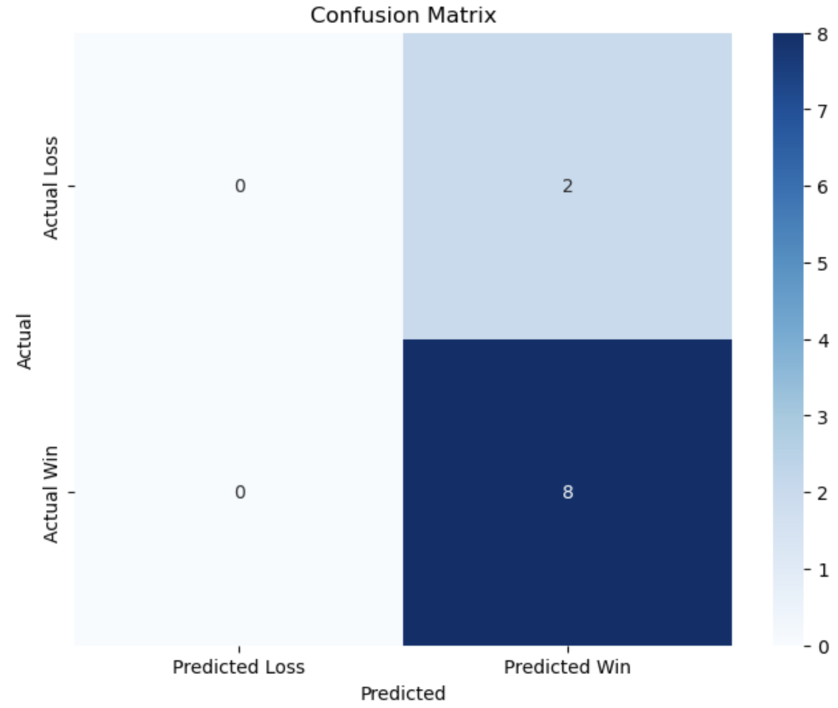
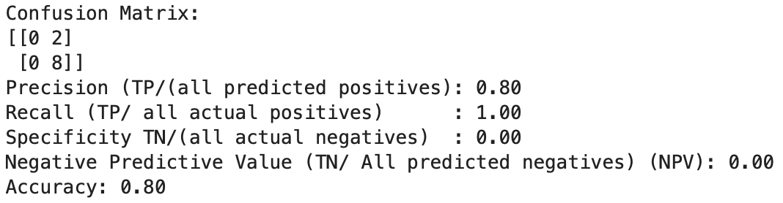
Phase I - Classical Machine Learning
Task 3: Model Training and Evaluation
Define feature set and labels
Split the data into training and test sets
Initialize Random Forest classifier
Predict the results on the test set
Calculate metrics for Random Forest

Slide 21
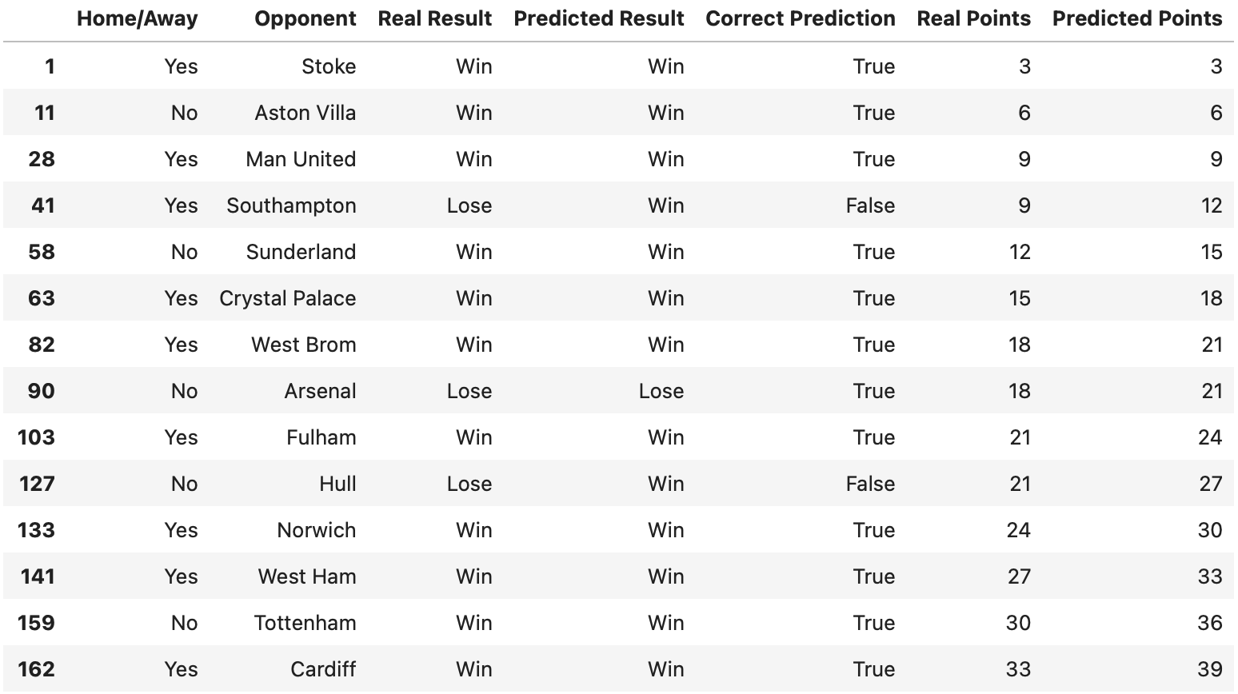
Phase I - Classical Machine Learning
Task 3: Model Training and Evaluation
Predict the results on the entire dataset

Slide 22
Phase II
Quantum Machine Learning Translation
Objective:
Translate the classical model into a quantum machine learning model
Approach:
Use parameterized quantum circuits (PQCs) to implement the model
Tasks:
Translate classical features into quantum features
Implement and test quantum model
Evaluate the model

Slide 23
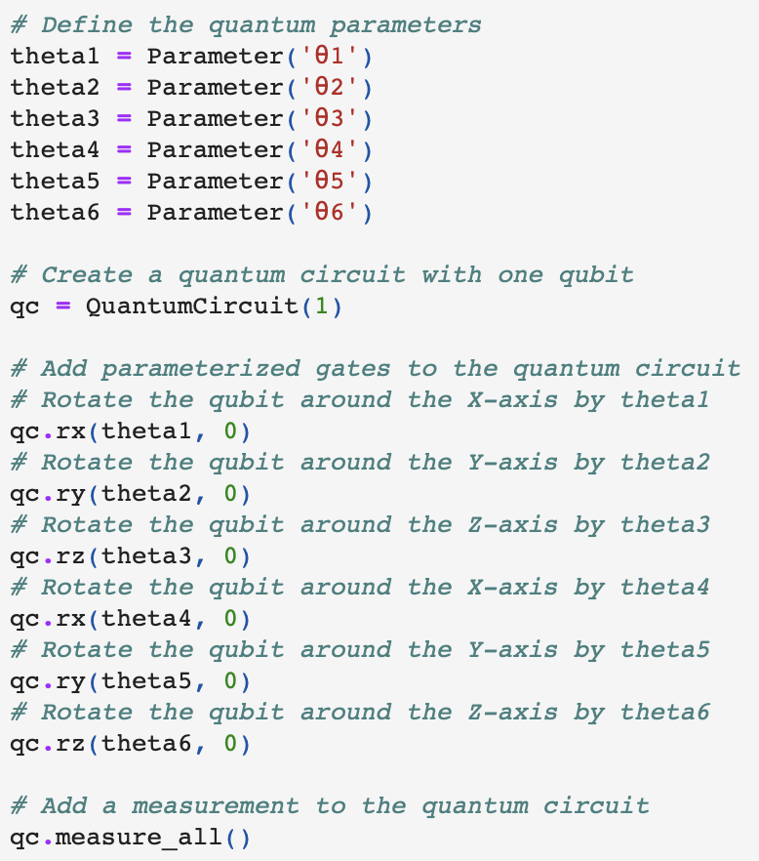
Overview of Steps
Quantum Circuit Construction: Build a quantum circuit where the classical features are encoded into the quantum state via parameterized rotation gates
Execution on a Quantum Simulator: Execute on the QASM simulator (which mimics the behavior of a quantum processor)
The circuit is run multiple times to gather measurement statistics.
Classification Based on Measurements: Classify the match result (win or loss) based on the measurement result
If the qubit measurement is more likely to be 0, we predict a loss; if it’s 1, we predict a win.

Slide 24
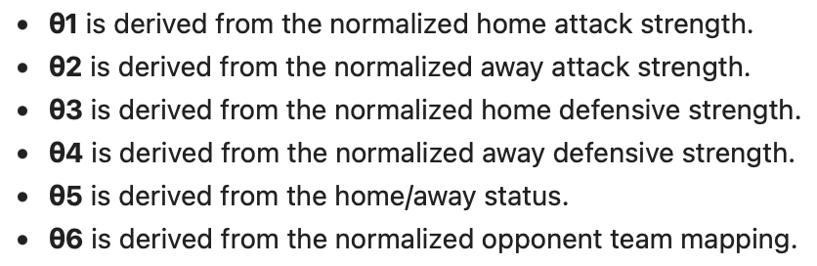
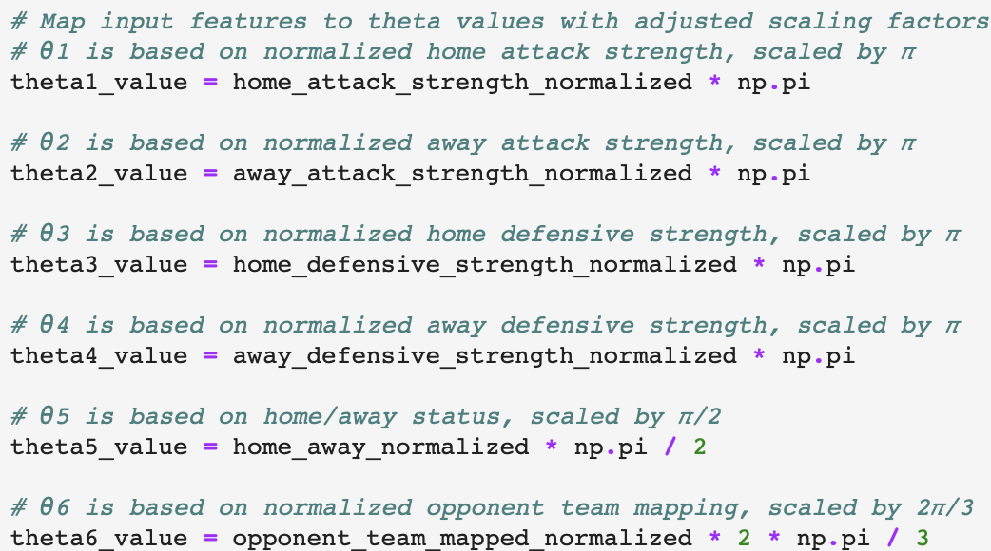
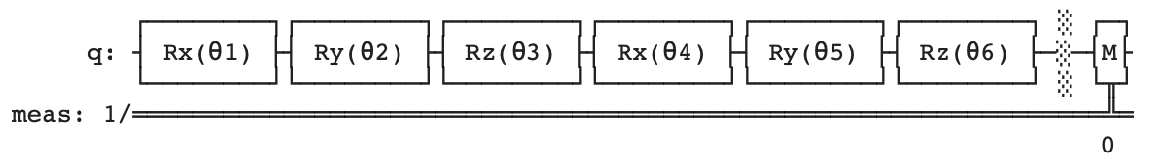
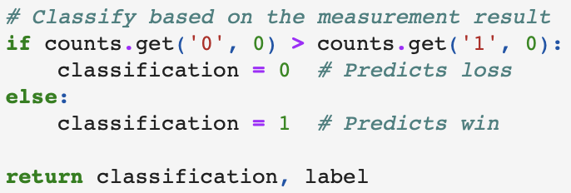
Phase II - One Qubit
Task 1: Translation from Classical to Quantum Features
Map normalized features to a specific quantum gate parameter (θ1, θ2, etc.)
Build a quantum circuit where the classical features are encoded into the quantum state via parameterized rotation gates
Task 2: Quantum Model Implementation and Testing
Execute it on the QASM simulator, which mimics the behavior of a quantum processor
Classify the match result (win or loss) based on the measurement result
If the qubit measurement is more likely to be 0, we predict a loss; if it’s 1, we predict a win

Slide 25
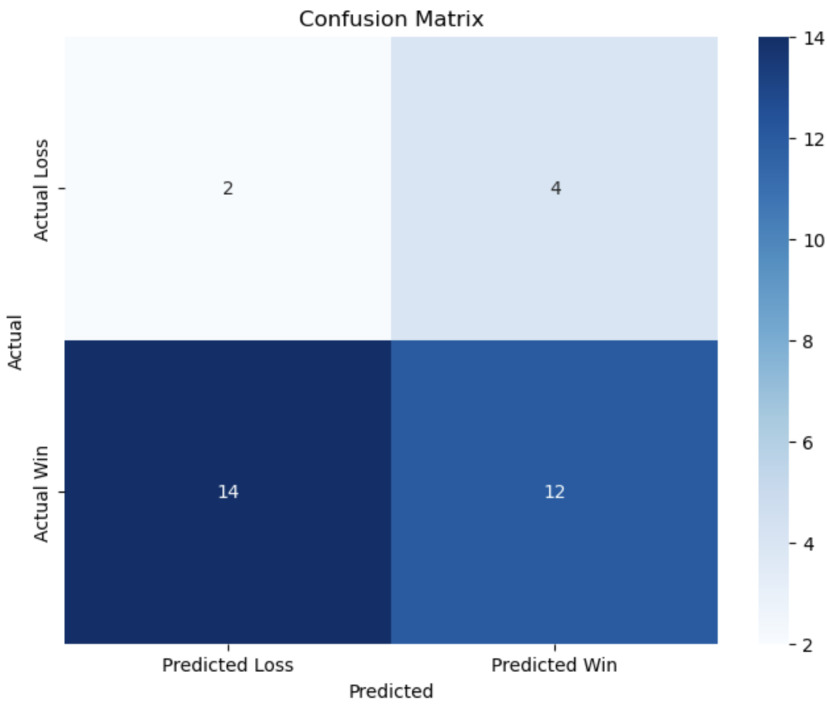
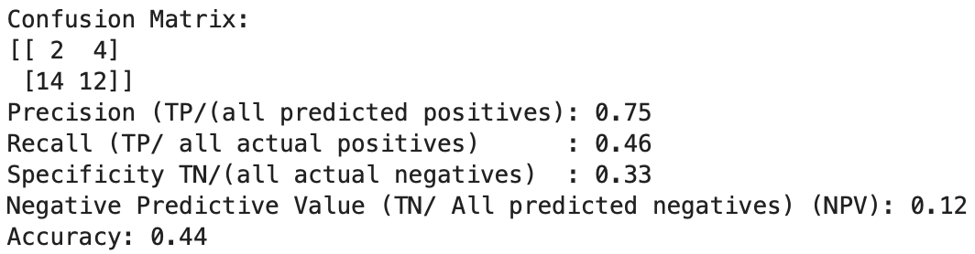
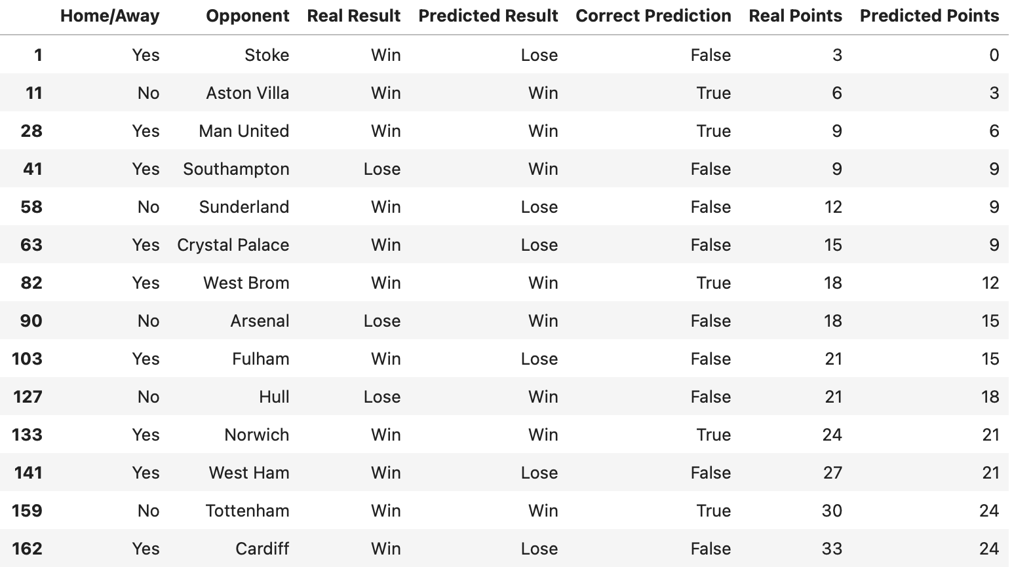
Phase II - One Qubit
Task 3: Model Evaluation & Prediction
Predict the results

Slide 26
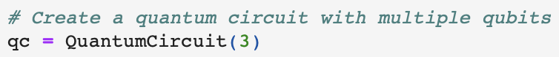
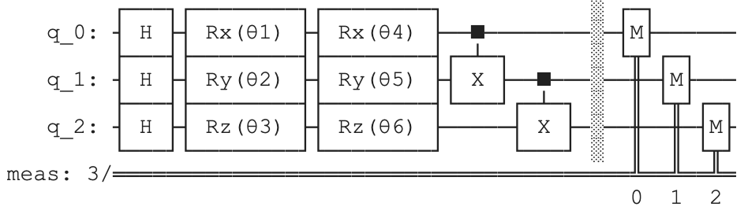
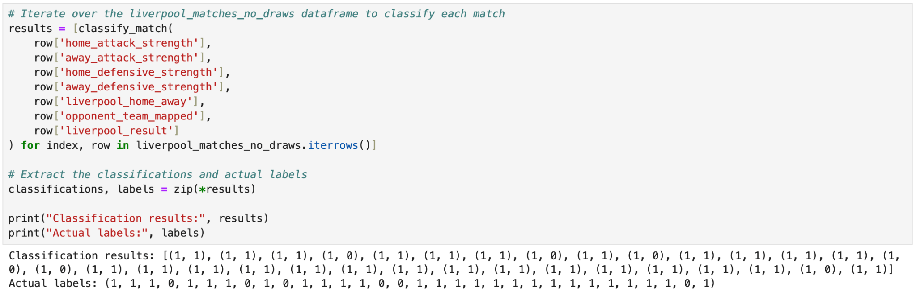
Phase II - Multiple Qubits
Task 1: Multiple Qubits Preparation
Define the quantum parameters
Create a quantum circuit with multiple qubits
Add Hadamard gates to create superposition
Add paratermized gates to the quantum circuit
Add CNOT gates to create entanglement
Add a measurement to a quantum circuit
Task 2: Same Tasks Applied to Multiple Qubits
Normalize the input features to a range [0, 1]
Map input features to theta values with adjusted scaling factors
Create a new quantum circuit with mapped values
Execute the circuit on qasm_simulator for measurement
Classify based on measurement result
Notes:
normalized features such as attack strength and defensive strength are used to determine the rotation angles of the qubits. The rotation gates (RX, RY, and RZ) manipulate the qubits according to the feature values.

Slide 27
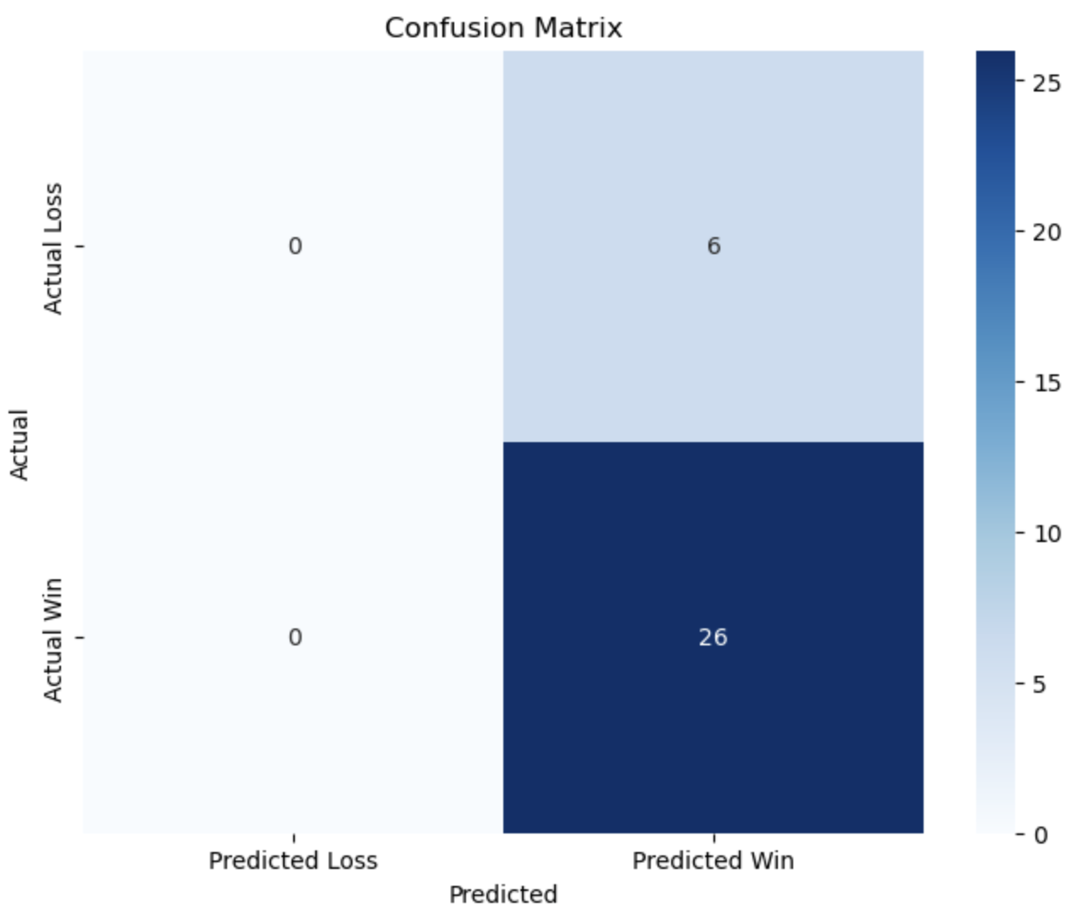
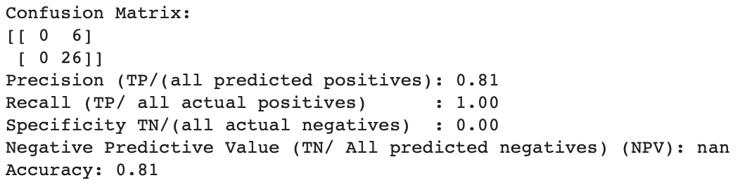
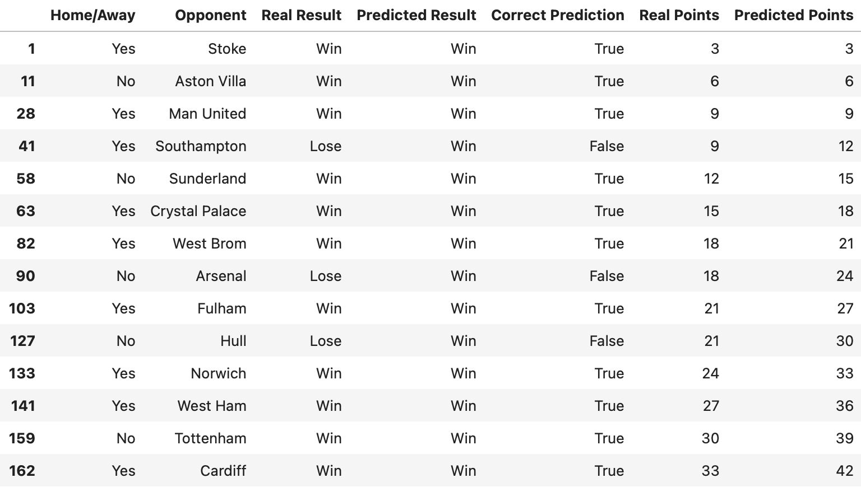
Phase II - Multiple Qubits
Task 3: Model Evaluation & Result Prediction

Slide 28

PQC Enhancements for Predictive Modeling
Quantum
Superposition
Quantum
Entanglement
Improvement over
Classical
Represent multiple states simultaneously, allowing for more efficient exploration of the solution space
Capture complex relationships between features, making it more adaptable to different kinds of data
Higher accuracy, faster training for larger dataset
Benefits of PQCs in Football Analytics
Enhanced Accuracy
Scalability
Speed
Recognize complex patterns and interactions between features, leading to more precise predictions and insights
Process vast amounts of football data, such as player performance metrics, team foundations, and match events, handling larger datasets efficiently
Provide faster training times enabling real-time analysis, which is crucial for in-game strategies and post-match evaluations

Slide 29
Conclusion
 | Quiz 4 Classical | Quiz 4 Quantum | Classical | One Qubit Quantum | Multiple Qubits Quantum | Naive Bayes
Accuracy Score | 0.70 | 0.62 | 0.80 | 0.44 | 0.81 | 0.80
Future Directions:
Real-time data integration, including data from matches, player statistics, and external factors
Apply PQCs to other sports to gain insights into player performance, team dynamics and match outcomes across different context
Apply hybrid classical-quantum models, using classical algorithms for initial data processing and quantum techniques for complex pattern recognition and optimization

Slide 30
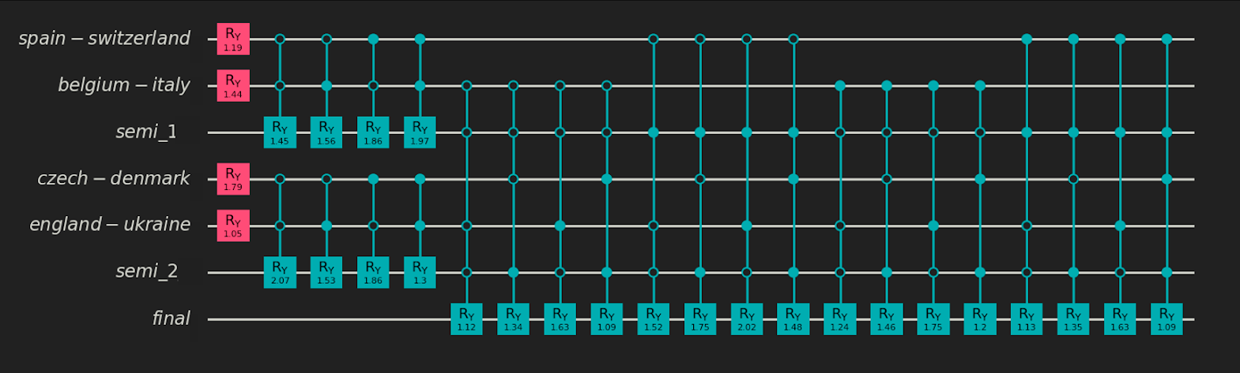
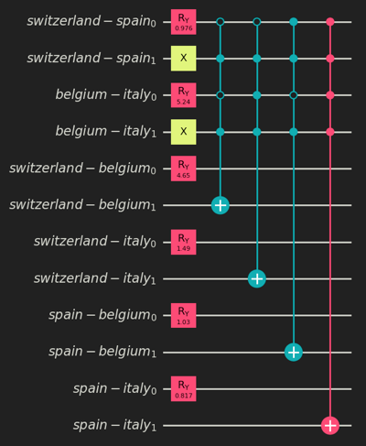
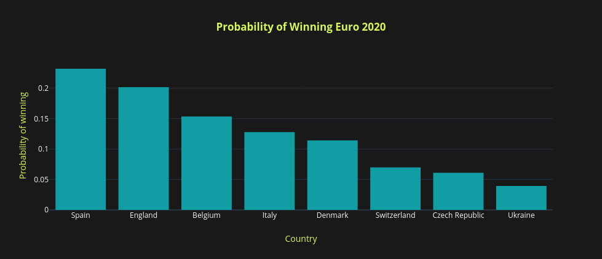
Reference - How Qubits Can Predict Euro 2020
Base assumption: The winning probability for each match between two specific teams is predetermined and known.
A probability p for the first team to win, and probability (1-p) for the second team to win
0 ≤ p ≤ 1
Round-based Approach
Matchup-based Approach: More qubits, fewer gates
Source Link : https://www.classiq.io/docs/quantum-football-how-qubits-can-predict-euro-2020
Notes:
https://www.classiq.io/docs/quantum-football-how-qubits-can-predict-euro-2020

Slide 31
Questions & Answers
Thank you for your attention! Any questions?

